Slide 1
PCA Lecture 24
Principal component analysis

Slide 2
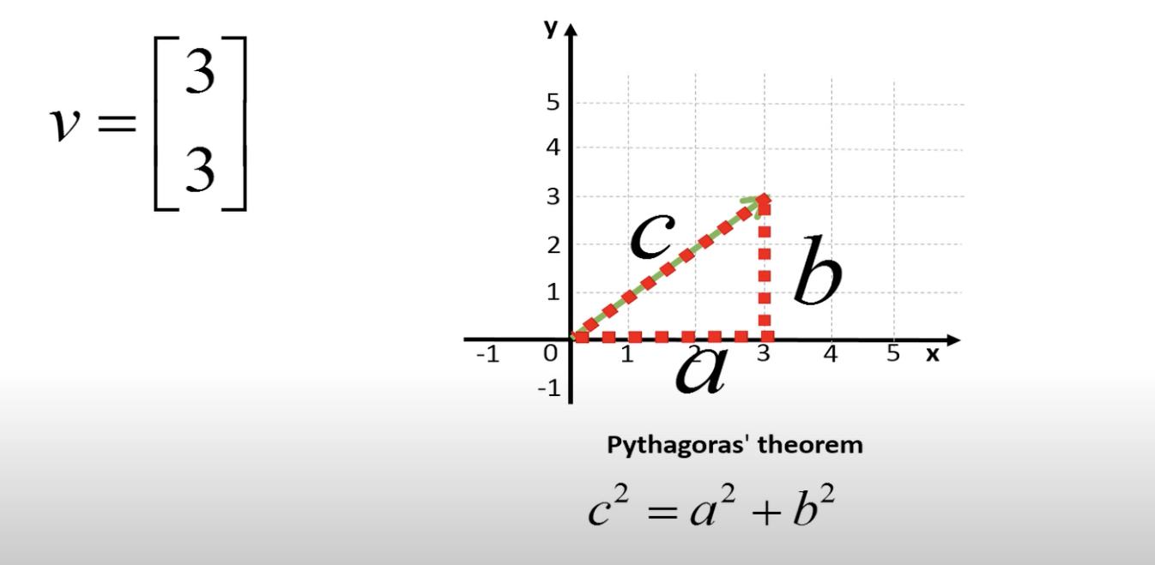
Vectors

Slide 3
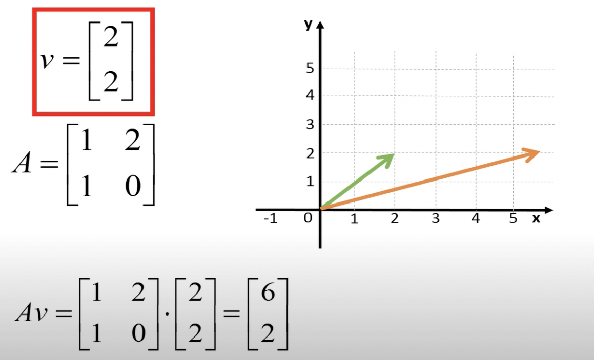
EigenVectors Av = ⋋v

Slide 4
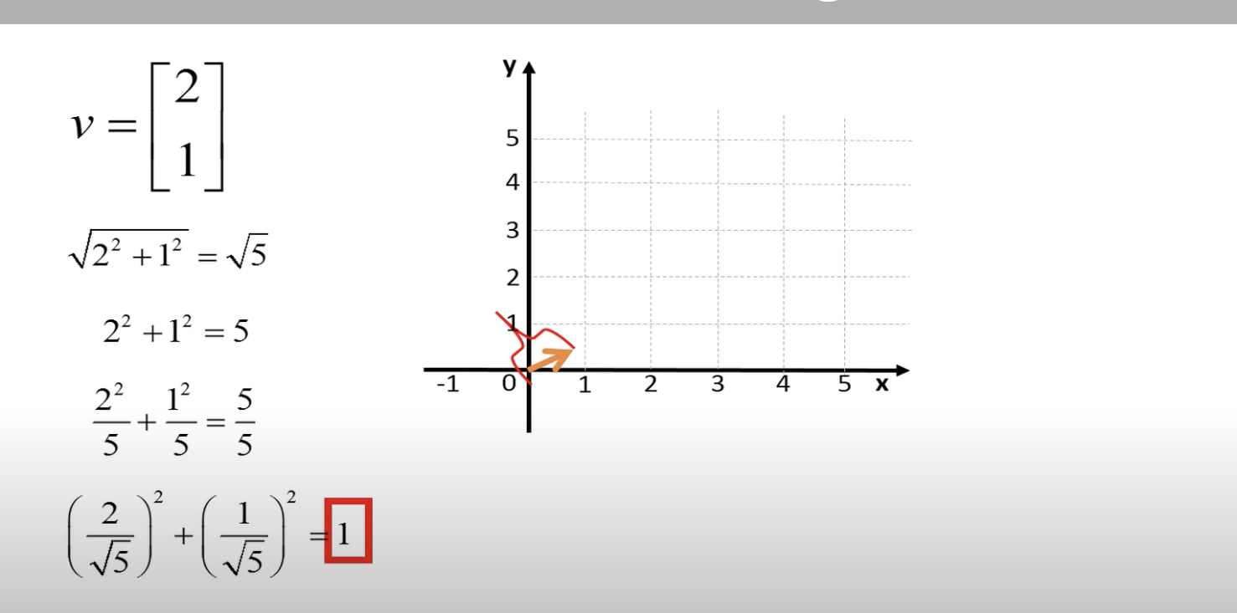
Normalizing Vector

Slide 5
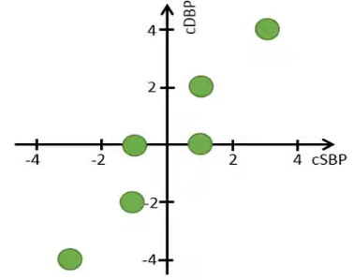
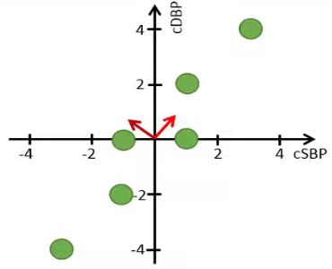
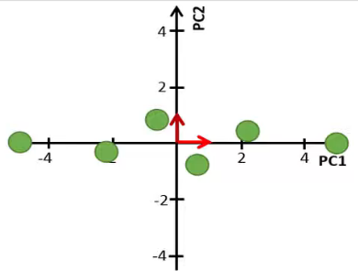
Principal Component Analysis
Try to increase variance but reduce covariance!! (i.e., make features independent via converting them to principal components)

Slide 6
Principal Component Analysis
Find a projection that captures the largest amount of variation in data
The original data are projected onto a much smaller space, resulting in dimensionality reduction.
We find the eigenvectors of the covariance matrix, and these eigenvectors define the new space

Slide 7
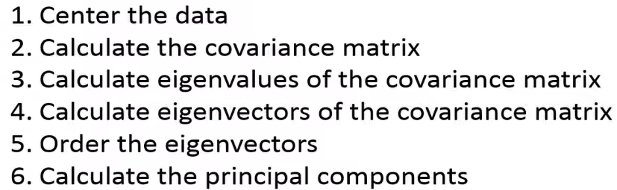
Principal Component Analysis

Slide 8
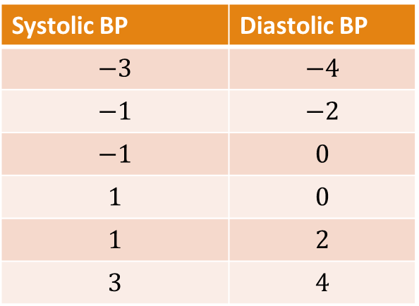

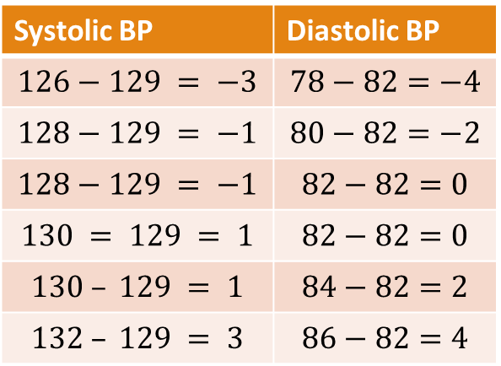






PCA: Step 1 – Center the data
Mean Center
Standardize
$$X_{new}=X−μ$$
$μ$ is average… also can use $\overline{X}$ as a notation.
$$X_{new}=\frac{X−μ}{σ}$$
Systolic BP | Diastolic BP
126 | 78
128 | 80
128 | 82
130 | 82
130 | 84
132 | 86
Systolic BP | Diastolic BP
$$126−129 = −3$$ | $$78−82=−4$$
$$128−129 = −1$$ | $$80−82=−2$$
$$128−129 = −1$$ | $$82−82=0$$
$$130 = 129 = 1$$ | $$82−82=0$$
$$130 – 129 = 1$$ | $$84−82=2$$
$$132 – 129 = 3$$ | $$86−82=4$$
Systolic BP | Diastolic BP
$$−3$$ | $$−4$$
$$−1$$ | $$−2$$
$$−1$$ | $$0$$
$$1$$ | $$0$$
$$1$$ | $$2$$
$$3$$ | $$4$$
$$μ=129$$
$$μ=82$$
$$μ=0$$
$$μ=0$$

Slide 9
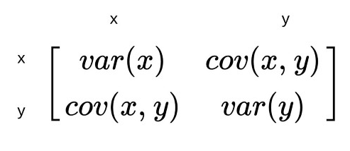


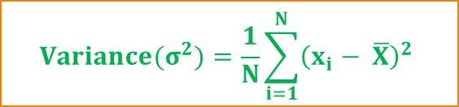
PCA: Step 2 – Compute Covariance
$${Variance(σ}^{2})=\frac{1}{N}\sum_{i=1}^{N}{{\left(x_{i}− \overline{X}\right)}^{2}}$$
Population Covariance
$$Cov\left(A,B\right)=\frac{\sum_{i=1}^{n}{\left(x_{i}− \overline{X}\right)×\left(y_{i}−\overline{Y}\right)}}{N}$$
Sample Covariance
Reduce This
Increase This
$$Cov\left(A,B\right)=\frac{\sum_{i=1}^{n}{\left(x_{i}− \overline{X}\right)×\left(y_{i}−\overline{Y}\right)}}{N−1}$$
Note: Variance is special case of covariance where two attributes are identical (covariance with itself)

Slide 10

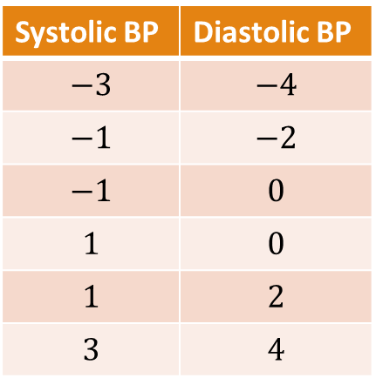




PCA: Step 2 – Compute Covariance
Systolic BP | Diastolic BP
$$−3$$ | $$−4$$
$$−1$$ | $$−2$$
$$−1$$ | $$0$$
$$1$$ | $$0$$
$$1$$ | $$2$$
$$3$$ | $$4$$
$${Variance(σ}^{2})=\frac{1}{N−1}\sum_{i=1}^{N}{{\left(x_{i}− \overline{X}\right)}^{2}}$$
$$Cov\left(A,B\right)=\frac{\sum_{i=1}^{n}{\left(x_{i}− \overline{X}\right)×\left(y_{i}−\overline{Y}\right)}}{N−1}$$
$$var(SBP)=\frac{{\left(−3−0\right)}^{2}+{\left(−1−0\right)}^{2}+{\left(−1−0\right)}^{2}+{\left(1−0\right)}^{2}+{\left(1−0\right)}^{2}+{\left(3−0\right)}^{2}}{5}$$
$$var\left(SBP\right)=\frac{9+1+1+1+1+9}{5}=\frac{22}{5}$$
$$var\left(SBP\right)=4.4$$
$$μ=0$$
$$μ=0$$
 | SBP | DBP
SBP
DBP
$$4.4$$

Slide 11



PCA: Step 2 – Compute Covariance
Systolic BP | Diastolic BP
$$−3$$ | $$−4$$
$$−1$$ | $$−2$$
$$−1$$ | $$0$$
$$1$$ | $$0$$
$$1$$ | $$2$$
$$3$$ | $$4$$
$${Variance(σ}^{2})=\frac{1}{N−1}\sum_{i=1}^{N}{{\left(x_{i}− \overline{X}\right)}^{2}}$$
$$Cov\left(A,B\right)=\frac{\sum_{i=1}^{n}{\left(x_{i}− \overline{X}\right)×\left(y_{i}−\overline{Y}\right)}}{N−1}$$
Co$var(SBP, DBP)=\frac{\left(−3×−4\right)+\left(−1×−2\right)+\left(−1×0\right)+\left(1×0\right)+\left(1×2\right)+(3×4)}{5}$
$$Covar\left(SBP, DBP\right)=\frac{12+2+0+0+2+12}{5}=\frac{28}{5}$$
$$Covar\left(SBP, DBP\right)=5.5$$
$$μ=0$$
$$μ=0$$
 | SBP | DBP
SBP
DBP
$$4.4$$
$$5.6$$
$$5.6$$
$$8.0$$

Slide 12
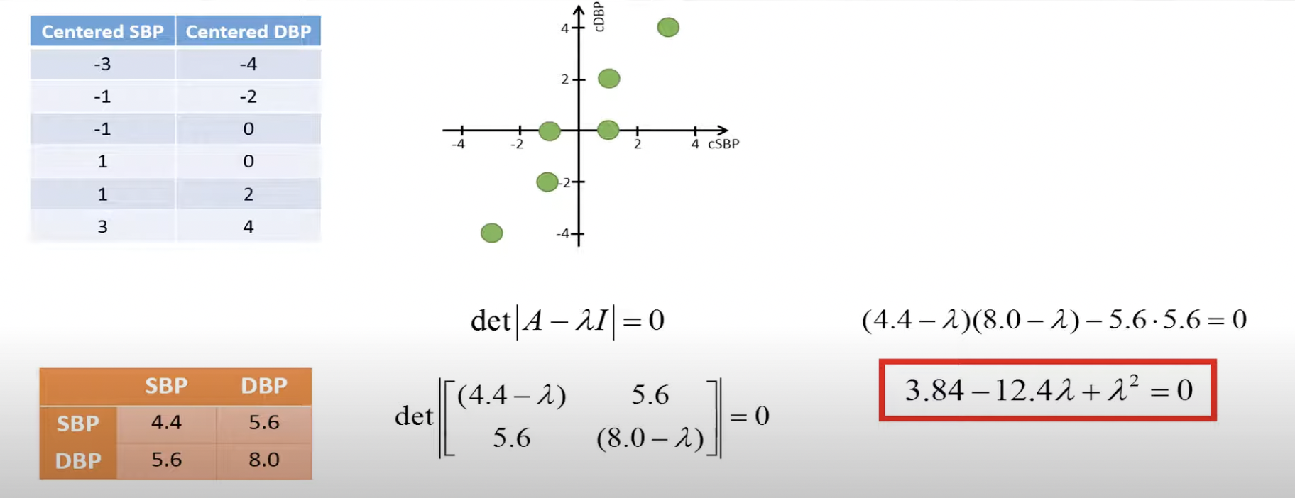
PCA: Step 2 – Compute Eigen Values
⋋1 = 12.08 ⋋2 = 0.32

Slide 13
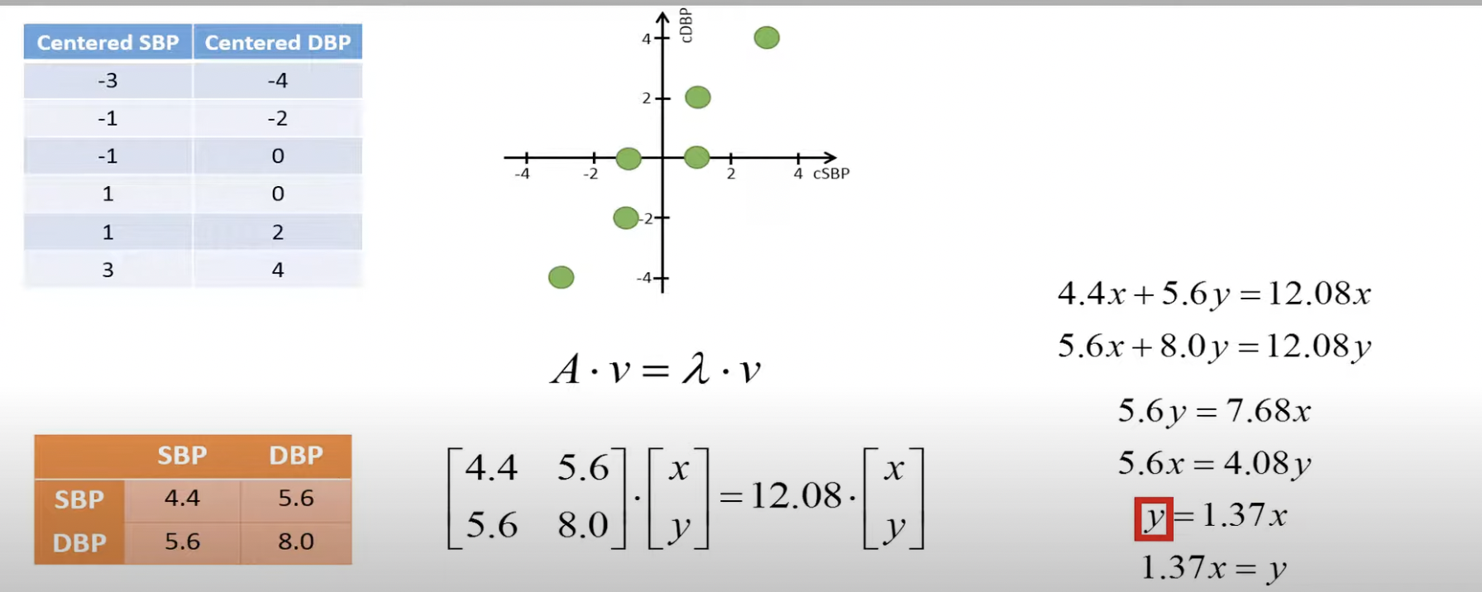
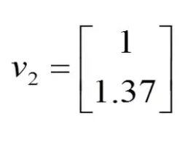
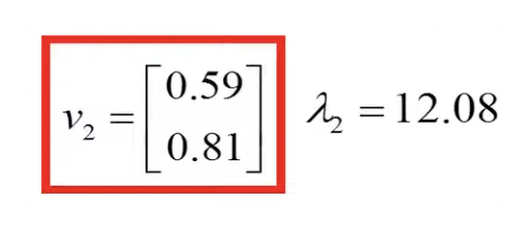
PCA: Step 3 – Compute Eigen Vectors

Slide 14
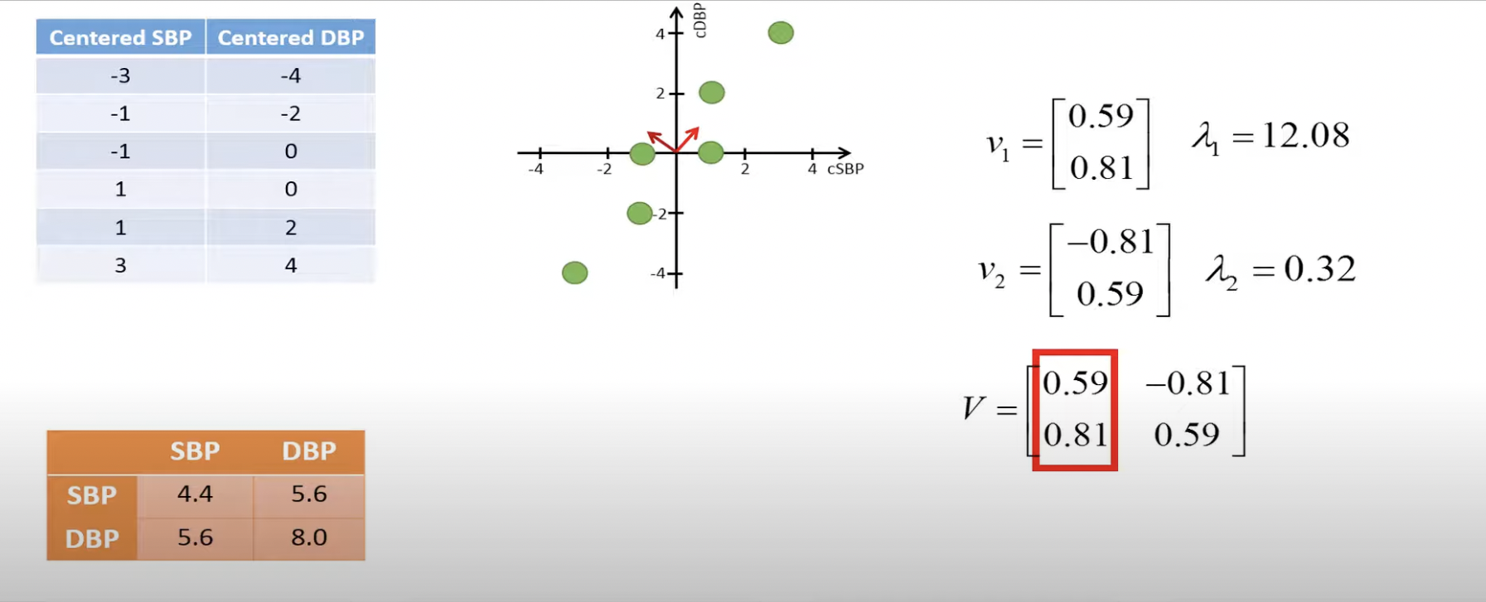
PCA: Step 4 – Order Eigen Vectors

Slide 15


PCA: Step 3 and 4 – Eigenvalues and Eigenvectors
Systolic BP | Diastolic BP
$$−3$$ | $$−4$$
$$−1$$ | $$−2$$
$$−1$$ | $$0$$
$$1$$ | $$0$$
$$1$$ | $$2$$
$$3$$ | $$4$$
$$×$$
0.59 | -0.81
0.81 | 0.59
$$=$$
How to get these eigen vectors?
 | SBP | DBP
SBP
DBP
$$4.4$$
$$5.6$$
$$5.6$$
$$8.0$$

Slide 16




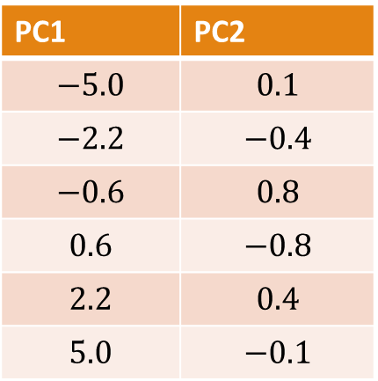

PCA: Step 5 – Compute Principal Components
Systolic BP | Diastolic BP
$$−3$$ | $$−4$$
$$−1$$ | $$−2$$
$$−1$$ | $$0$$
$$1$$ | $$0$$
$$1$$ | $$2$$
$$3$$ | $$4$$
PC1 | PC2
$$−5.0$$ | $$0.1$$
$$−2.2$$ | $$−0.4$$
$$−0.6$$ | $$0.8$$
$$0.6$$ | $$−0.8$$
$$2.2$$ | $$0.4$$
$$5.0$$ | $$−0.1$$
Transformed Data (or Principal Components)
$$×$$
0.59 | -0.81
0.81 | 0.59
$$=$$
How to get these eigen vectors?
 | PC1 | PC2
PC1
PC2
 | SBP | DBP
SBP
DBP
$$12.08$$
$$0$$
$$4.4$$
$$5.6$$
$$0$$
$$0.32$$
$$5.6$$
$$8.0$$
$$Percentage Variance of PC1=\frac{12.08}{12.08+.0.32}=97.41\%$$

Slide 17
PCA: Reduce Dimensions
Systolic BP | Diastolic BP
$$−3$$ | $$−4$$
$$−1$$ | $$−2$$
$$−1$$ | $$0$$
$$1$$ | $$0$$
$$1$$ | $$2$$
$$3$$ | $$4$$
PC1 | PC2
$$−5.0$$ | $$0.1$$
$$−2.2$$ | $$−0.4$$
$$−0.6$$ | $$0.8$$
$$0.6$$ | $$−0.8$$
$$2.2$$ | $$0.4$$
$$5.0$$ | $$−0.1$$
Transformed Data (or Principal Components)
$$×$$
0.59 | -0.81
0.81 | 0.59
$$=$$
How to get these eigen vectors?
 | PC1 | PC2
PC1
PC2
 | SBP | DBP
SBP
DBP
$$12.08$$
$$0$$
$$4.4$$
$$5.6$$
$$0$$
$$0.32$$
$$5.6$$
$$8.0$$
$$Percentage Variance of PC1=\frac{12.08}{12.08+.0.32}=97.41\%$$

Slide 18
PCA in Python

Slide 19
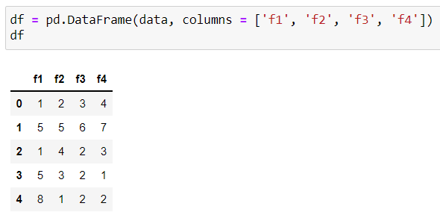
PCA Example via Python Code

Slide 20
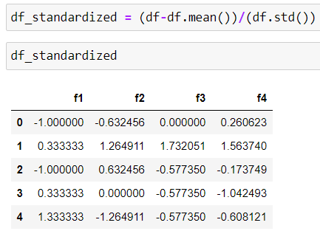
PCA Example via Python Code

Slide 21
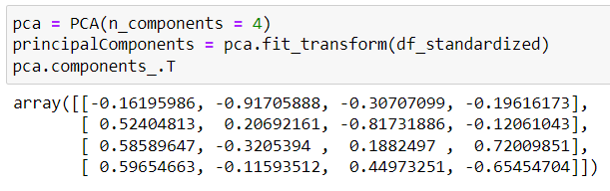
PCA Example via Python Code

Slide 22
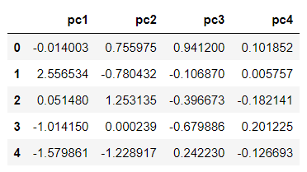
PCA Example via Python Code

Slide 23
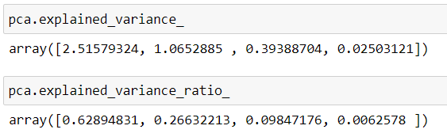
PCA Example via Python Code

Slide 24
Self Study
https://builtin.com/data-science/step-step-explanation-principal-component-analysis
https://towardsdatascience.com/the-mathematics-behind-principal-component-analysis-fff2d7f4b643
https://www.projectrhea.org/rhea/index.php/PCA_Theory_Examples
https://www.youtube.com/watch?v=_UVHneBUBW0&ab_channel=StatQuestwithJoshStarmer
https://youtu.be/FgakZw6K1QQ?list=PLUE9cBml08ygE5rkN42FanwMiNMNFzh5N

